Slide 1

INT247 Machine Learning Foundations
Lecture #3
Decision Trees and Random Forests

Slide 2
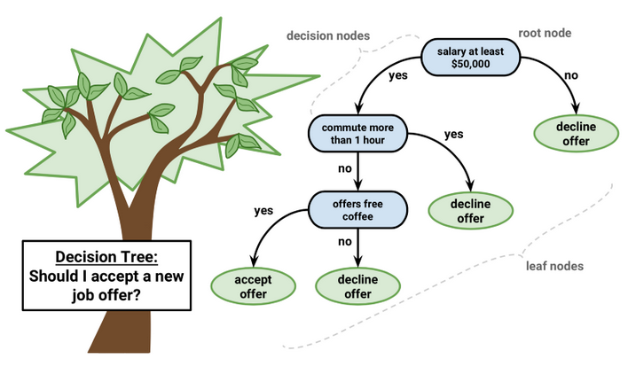
Decision Tree Learning
Breaking down data by making decisions based on asking a series of questions.

Slide 3
Decision Tree Learning
A decision tree consists of
Nodes
Test for the value of a certain attribute.
Edges
Correspond to the outcome of a test.
Connect to the next node or leaf.
Leaves
Terminal nodes that predict the outcome.

Slide 4
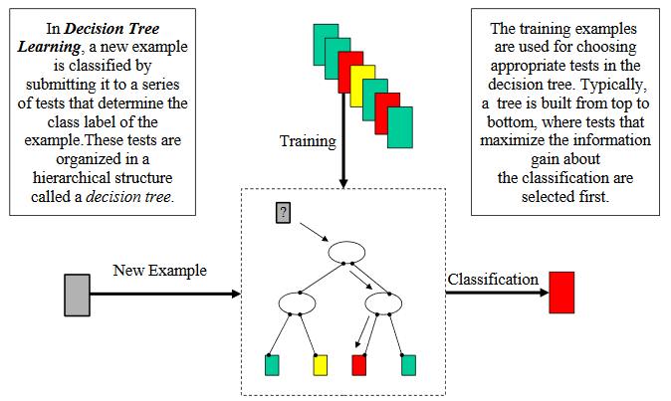
Algorithm
Start at the root.
Perform the test.
Follow the edge corresponding to outcome.
Goto step 2 unless leaf.
Predict the outcome associated with the leaf.

Slide 5
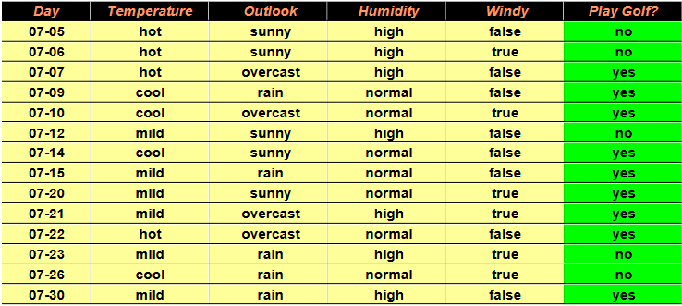
Design Decision Tree
Note: Consider “Outlook” as root node

Slide 6
Exercise

Slide 7
Good Attribute?
Prefers attributes that have a high degree of “order”.
Maximum Order: All examples are of the same class.
Minimum Order: All classes are equally likely.

Slide 8
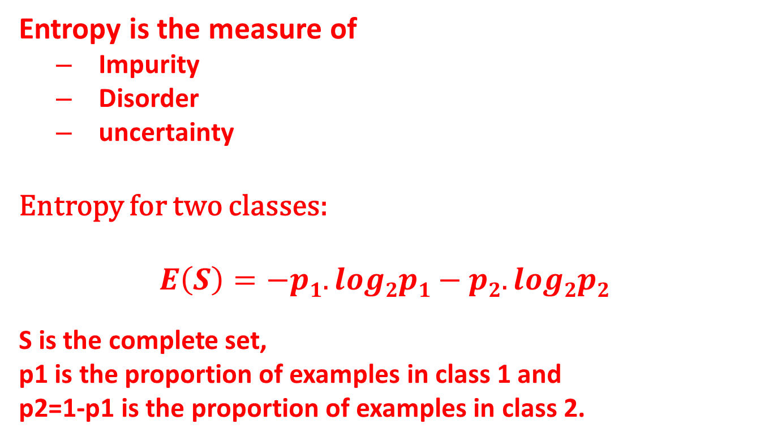
Entropy
Entropy is the measure of
Impurity
Disorder
uncertainty
Entropy for two classes:
$$E\left(S\right)=−p1.log2p1−p2.log2p2$$
S is the complete set,
p1 is the proportion of examples in class 1 and
p2=1-p1 is the proportion of examples in class 2.

Slide 9
Exercise
Compute entropy
Outlook=sunny
Outlook=overcast
Outlook=rainy

Slide 10
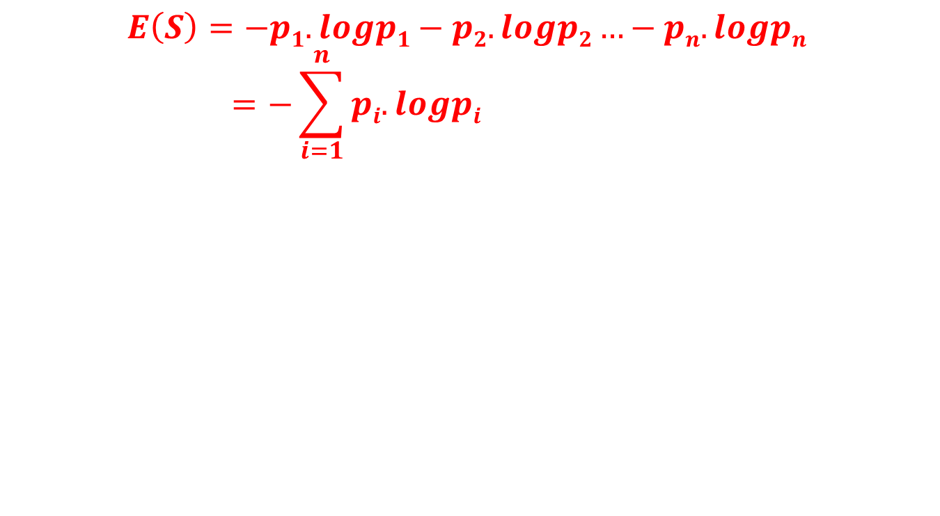
Entropy for more classes
$$E\left(S\right)=−p1.logp1−p2.logp2…−pn.logpn=−\sum_{i=1}^{n}{pi.logpi}$$

Slide 11
Entropy Disadvantages
Only computes the quality of a single subset of examples corresponds to a single value.

Slide 12
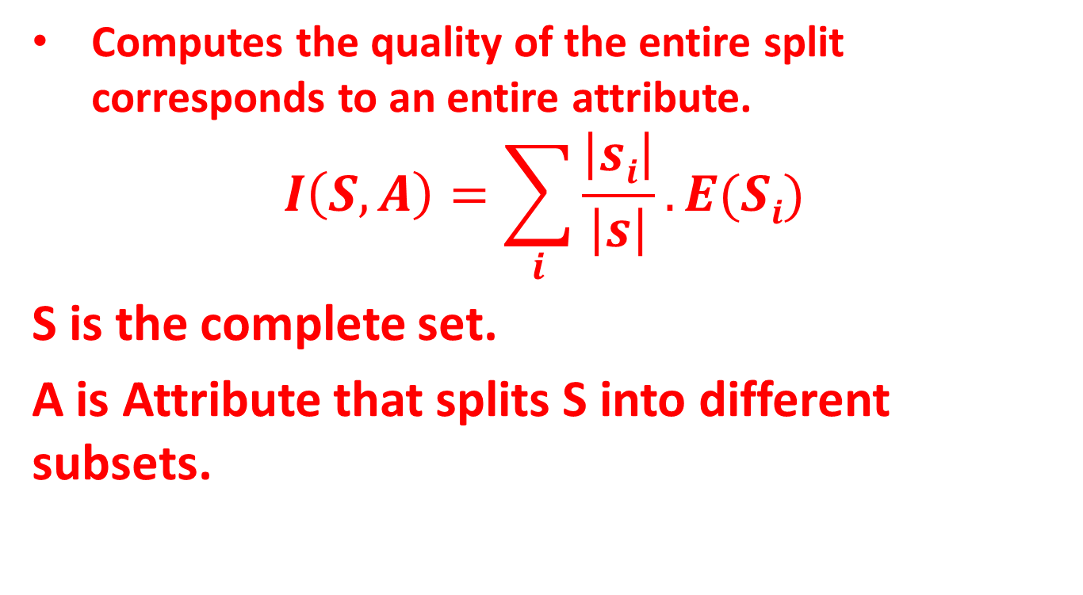
Average Entropy
Computes the quality of the entire split corresponds to an entire attribute.
$$I\left(S,A\right)=\sum_{i}{\frac{\left|si\right|}{\left|s\right|}}.E(Si)$$
S is the complete set.
A is Attribute that splits S into different subsets.

Slide 13
Properties of Entropy
When node is pure, measure should be zero.
When impurity is maximal, measure should be maximal.

Slide 14
Exercise
Compute the average entropy for attribute “Outlook”.

Slide 15
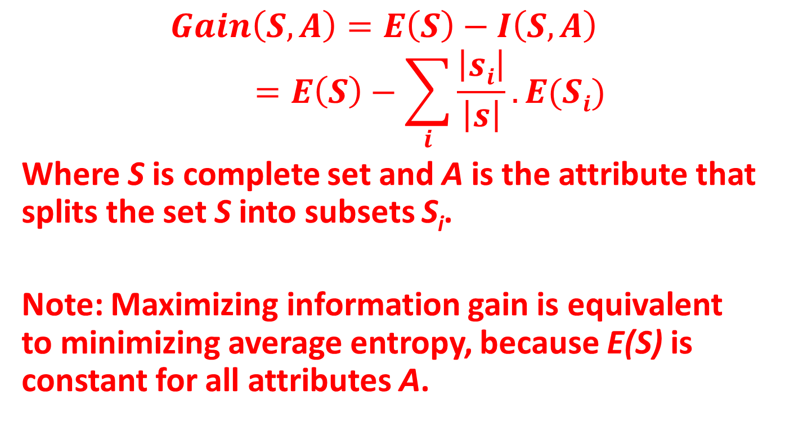
Information Gain
$$Gain\left(S,A\right)=E\left(S\right)−I\left(S,A\right)=E\left(S\right)−\sum_{i}{\frac{\left|si\right|}{\left|s\right|}}.E(Si)$$
Where S is complete set and A is the attribute that splits the set S into subsets S_{i}.
Note: Maximizing information gain is equivalent to minimizing average entropy, because E(S) is constant for all attributes A.

Slide 16
Exercise
Compute the information gain for
Gain(S, Humidity)=?
Gain(S, Wind)=?
Gain(S, Outlook)=?
Gain(S, Temperature)=?
Note:
The attribute with maximum information gain is selected as root node.

Slide 17
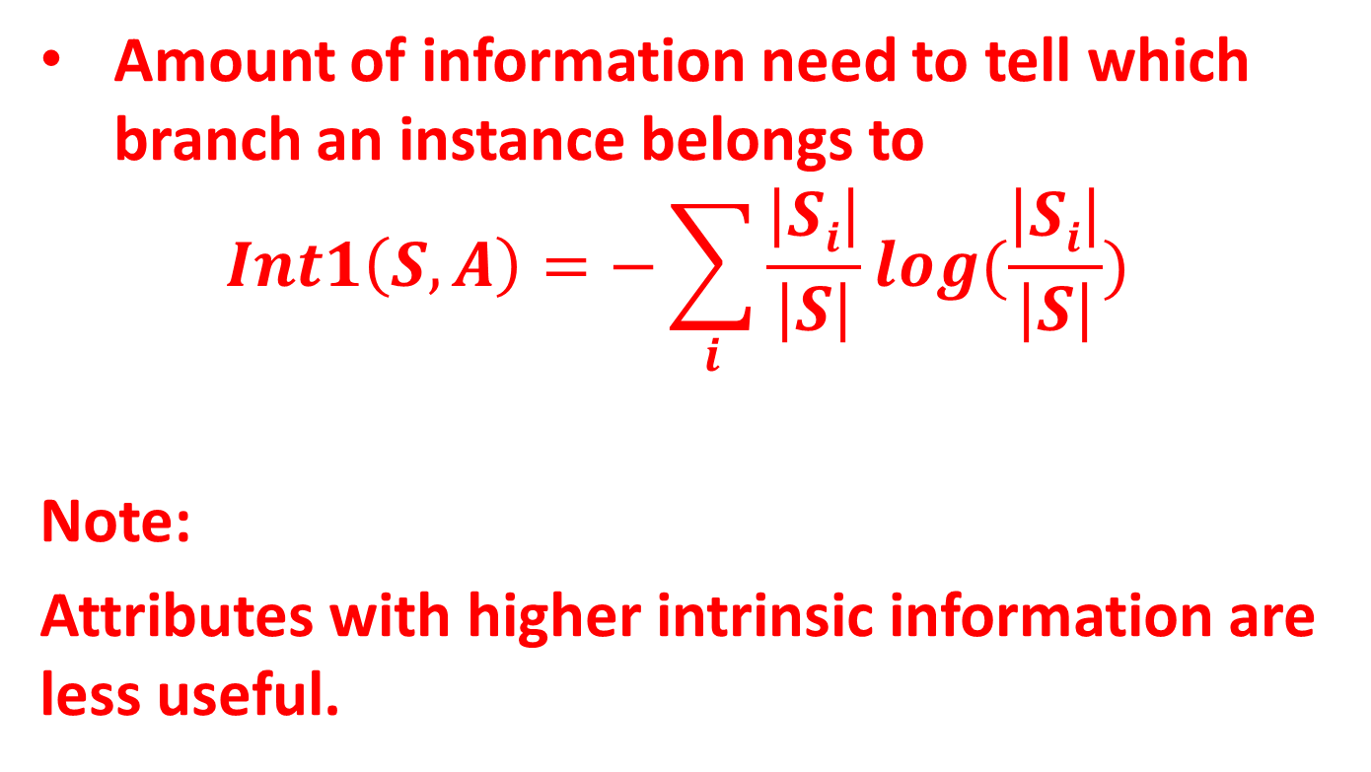
Intrinsic Information of an attribute
Amount of information need to tell which branch an instance belongs to
$$Int1\left(S,A\right)=−\sum_{i}{\frac{\left|Si\right|}{\left|S\right|}log(\frac{\left|Si\right|}{\left|S\right|})}$$
Note:
Attributes with higher intrinsic information are less useful.

Slide 18
Exercise
Compute intrinsic information of
Day
Temperature
Humidity
Windy
Outlook

Slide 19
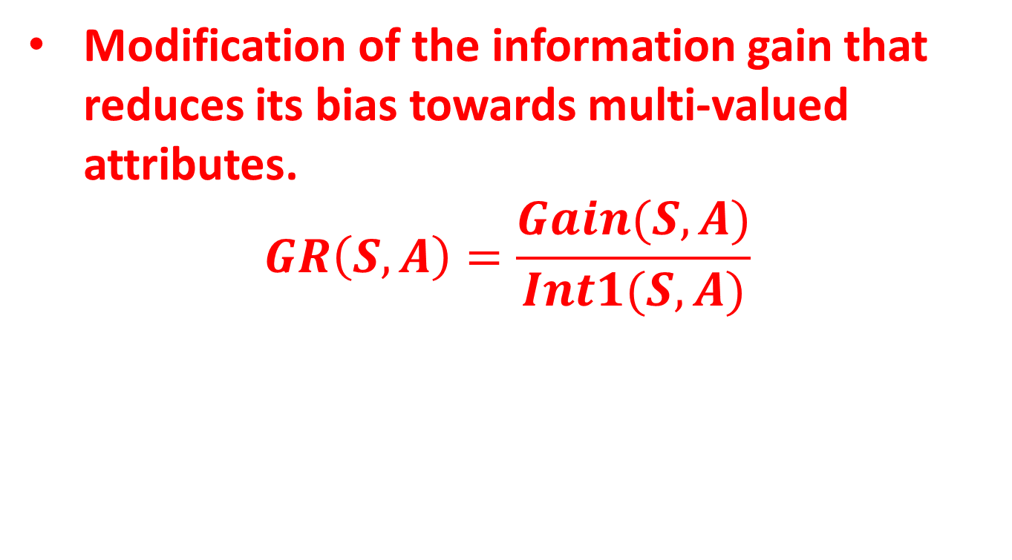
Gain Ratio
Modification of the information gain that reduces its bias towards multi-valued attributes.
$$GR\left(S,A\right)=\frac{Gain(S,A)}{Int1(S,A)}$$

Slide 20
Exercise
Compute gain ratio of
Day
Temperature
Humidity
Windy
outlook

Slide 21
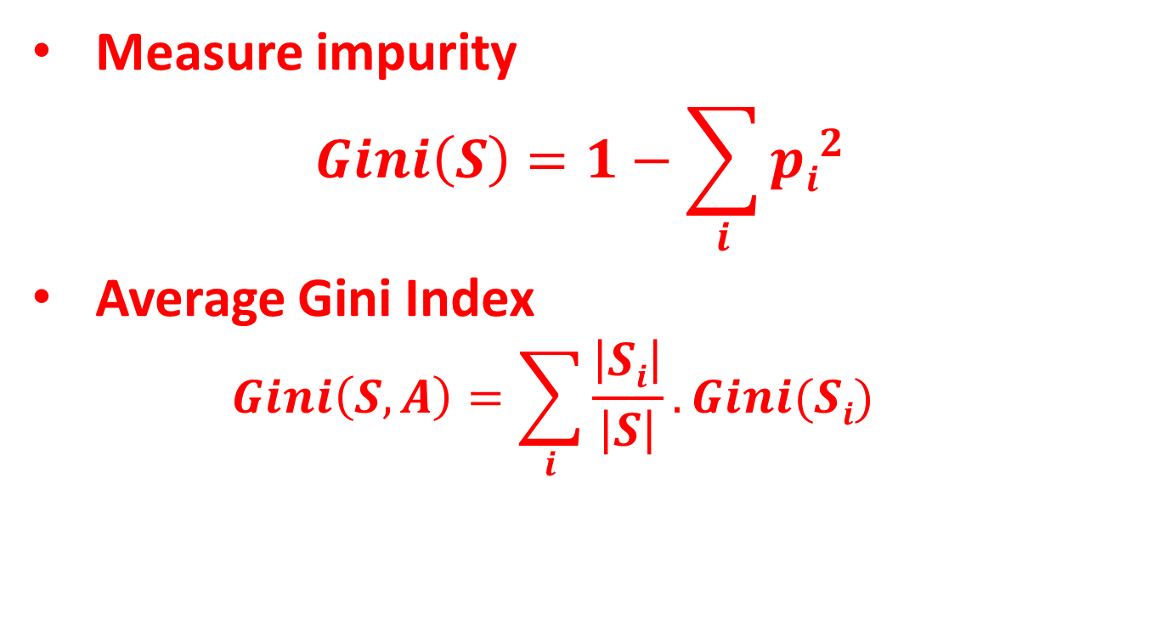
Gini Index
Measure impurity
$$Gini\left(S\right)=1−\sum_{i}{{pi}^{2}}$$
Average Gini Index
$$Gini\left(S,A\right)=\sum_{i}{\frac{\left|Si\right|}{\left|S\right|}.Gini(Si)}$$

Slide 22
Pruning
Pre-pruning:
Stop growing a branch when information becomes unreliable.
Post-pruning:
Grow a decision tree that correctly classifies all training data.
Simplify it later by replacing some nodes with leafs.

Slide 23
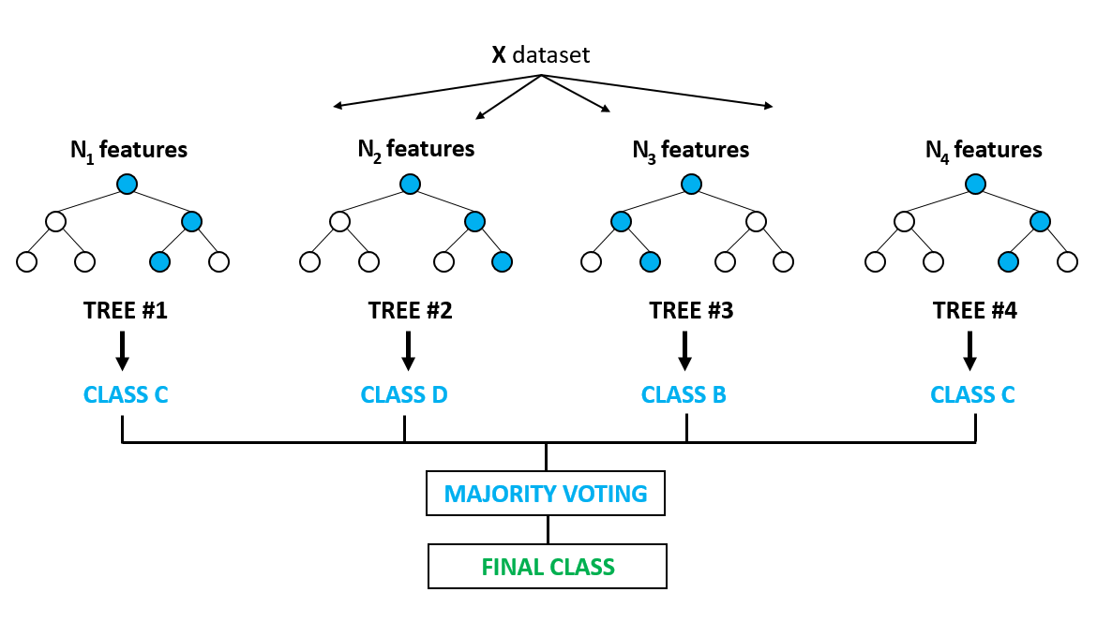
Random Forest
Builds multiple decision tree and merges them together to get a more accurate and stable prediction.

Slide 24
Random Forest Creation Algorithm
Randomly select “K” features from total “m” feaures.
Where K << m
Among the “K” features, calculate the node “d” using the best split point.
Split the node into daughter nodes using the best split.
Repeat 1 to 3 steps until “l” number of nodes has been reached.
Build forest by repeating steps 1 to 4 for “n” number of times to create “n” number of trees.

Slide 25
Random Forest Prediction Algorithm
Takes the test features and use the rules of each randomly created decision tree to predict the outcome and stores the predicted outcome.
Calculate the vote for each predicted target.
Consider the high voted predicted target as the final prediction from the random forest algorithm.

Slide 26
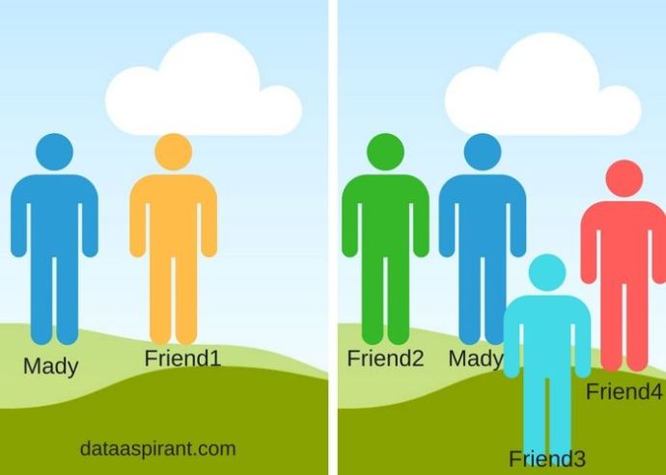
Random Forest Example
Mady takes opinion from friends for some problem.

Slide 27
Why Random Forest Algorithm?
Can be used for both classification and regression.
Handles the missing value.
Not over-fit the model.

Slide 28
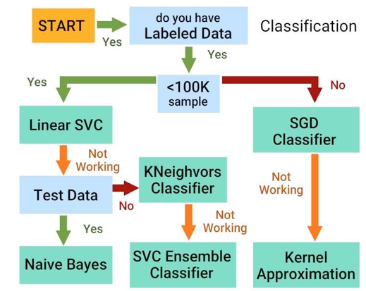
Algorithm Selection

Slide 29


